Slide 1
Secure Data Hiding in image Using Steganography
CAPSTONE PROJECT
Presented By : Sridevi S
Student Name : Sridevi S
College Name : Meenakshi College of Engineering, Chennai
Department : B.Tech Information Technology

Slide 2
OUTLINE
Problem Statement
Technology used
Wow factor
End users
Result
Conclusion
Git-hub Link
Future scope

Slide 3
Problem Statement
With the increasing digital exchange of information, ensuring confidentiality has become a significant challenge. Traditional encryption techniques, while secure, often draw attention, making them vulnerable to interception. An alternative solution is required—one that allows data to be concealed seamlessly within images, ensuring secure and unnoticed communication.

Slide 4
Technologies used
The project leverages modern technologies to achieve seamless steganography. Django, a powerful web framework, serves as the backbone, while OpenCV and NumPy facilitate efficient image processing. HTML and CSS ensure a user-friendly interface, while file handling and rendering functions enable smooth encryption and decryption workflows.

Slide 5
Wow factors
Enables covert communication by embedding messages within images.
Incorporates password protection to ensure only authorized access.
Provides a simple yet effective web-based tool for encryption and decryption.
No need for additional storage; the data remains within the image itself.
Supports various image formats, enhancing compatibility.

Slide 6
End users
This technology benefits a wide range of users, including:
Cybersecurity professionals safeguarding confidential communications.
Journalists and activists protecting sensitive information.
Law enforcement and intelligence agencies conducting covert operations.
Individuals seeking a private means of communication.

Slide 7
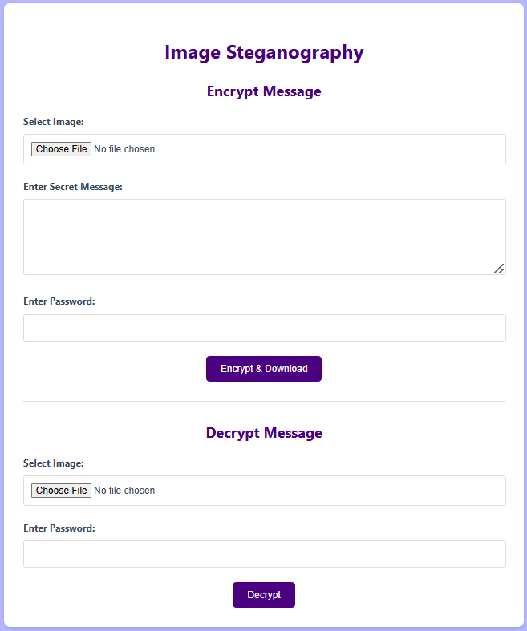
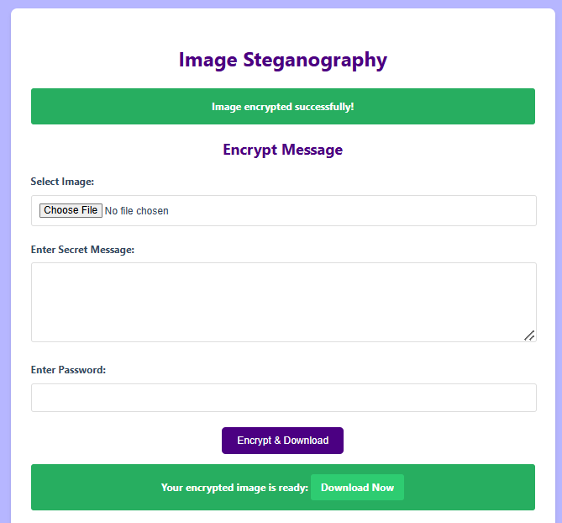

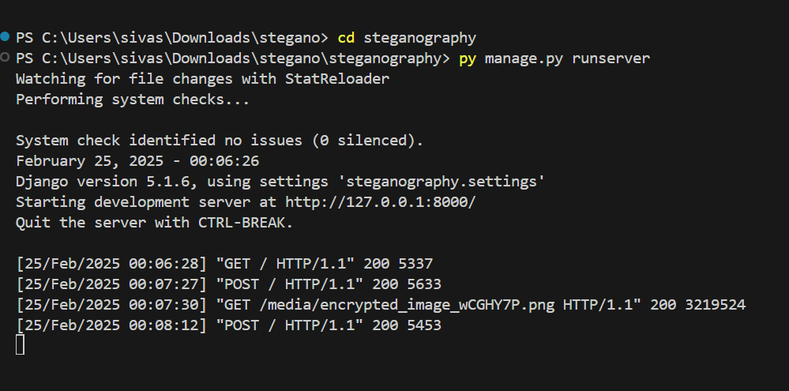
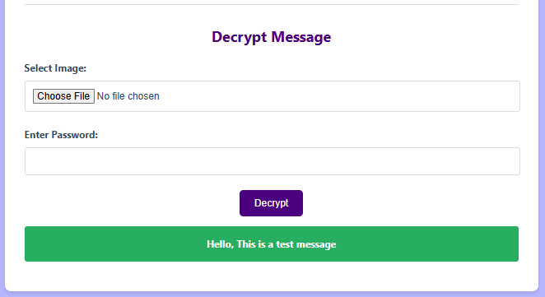
Results
The project successfully implements image steganography, ensuring secure and undetectable data hiding. Extensive testing confirms that message embedding does not compromise image quality, and retrieval accuracy is maintained. The password-protected system adds an additional security layer, ensuring message confidentiality.

Slide 8
Conclusion
This project demonstrates a reliable method for secure data concealment using steganography. By leveraging modern web and image processing technologies, it ensures message privacy without arousing suspicion. The ease of use and built-in security mechanisms make it a practical solution for confidential communication.

Slide 9
GitHub Link
https://github.com/sridevis15/Image-Stegnography.git

Slide 10
Future scope
Advanced Encryption: Implementing stronger cryptographic algorithms for enhanced security.
Multi-format Support: Expanding compatibility to additional image formats like PNG and GIF.
Mobile Application: Developing a smartphone-based solution for on-the-go steganography.
AI Integration: Utilizing machine learning to optimize data hiding techniques.
Cloud Storage: Enabling encrypted image storage for remote access.

Slide 11
THANK YOU

